Slide 1


Ghaith Mobile Application

Slide 2
Project Team
1
Gamal Barakat Gamal
2
Ebrahem Mohamed
3
Ahmed mostafa
4
Youssef Mohamed
Supervised by
Engineer Esraa Fathy

Slide 3
Contents
1- Introduction
2- User Interface

Slide 4


Introduction

Slide 5
Introduction
Our project name is Ghaith. It works on create an application to facilitate donations to people and speed rescue in natural disasters that occur in some governorates. The general goal is to create an application for donations to facilitate and speed up the work of charities.
And You can donate with any thing you want (Clothes , Food Meals , Medicine , etc. ) , Unlike others that only donate money.
People in need most of the time need more important things than money to be able to live. With Ghaith Application You can do it in easily different ways.

Slide 6
Features
User Friendly Interface.
Cash or Online Payment Contributed integrated with secured Payment Gateways.
You Can donate with anything you have, not only money.
Different donation categories.
Volunteering during announced volunteer campaigns.
You can donate generally in any category you want instead of donating to a specific cause through an announced instrument

Slide 7

Project Pipeline
Enter details of Donations
Check Payment Success
Register Or Login
2
4
6
1
3
5
7
Splash and On Boarding Screens
Home Page (Choose how to donate)
Enter details of Payment
Return to Home Page or Log out

Slide 8

User Interface

Slide 9
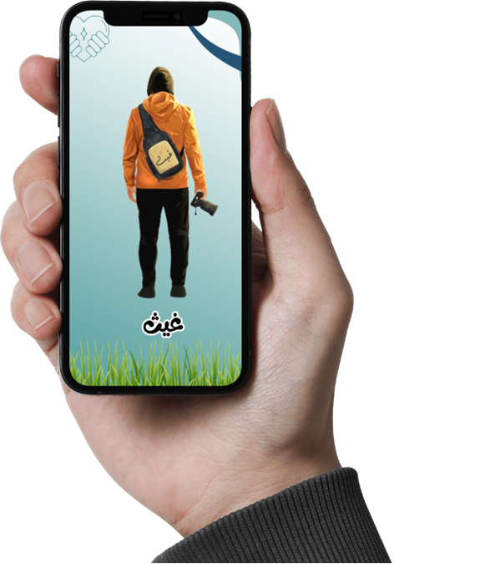
User Interface
Splash Screen

Slide 10
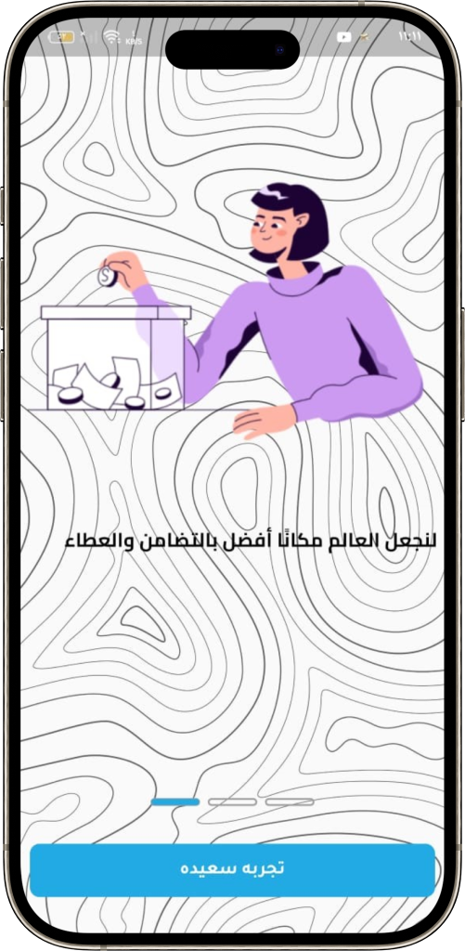
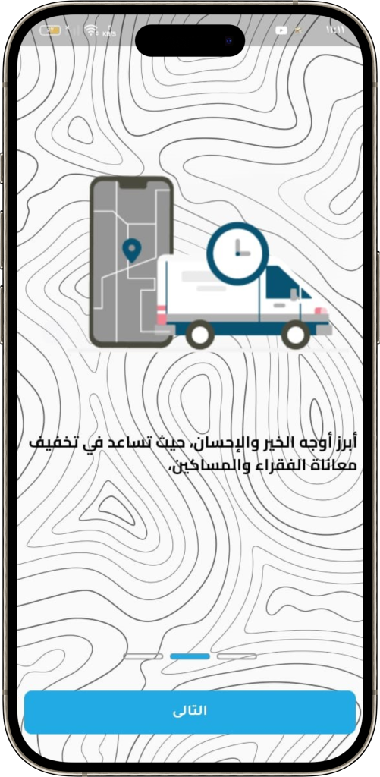
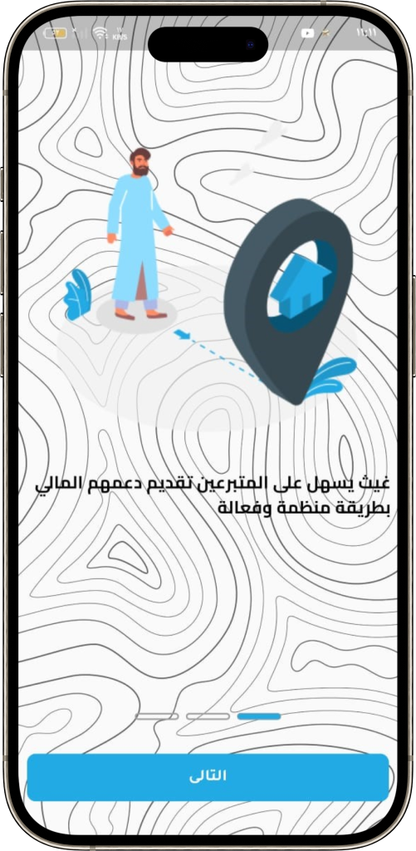
On Boarding Screens

Slide 11
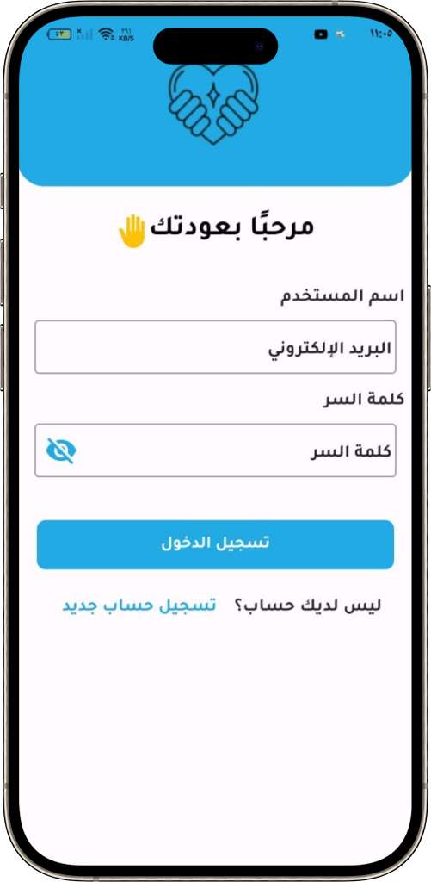
Login Screen

Slide 12
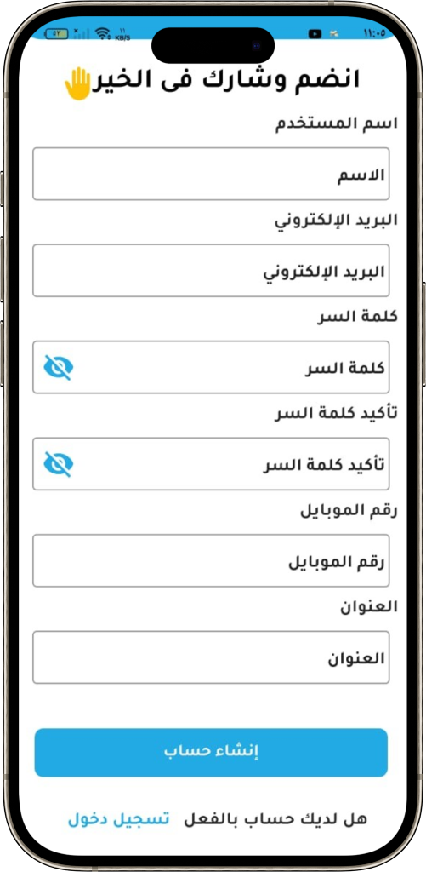
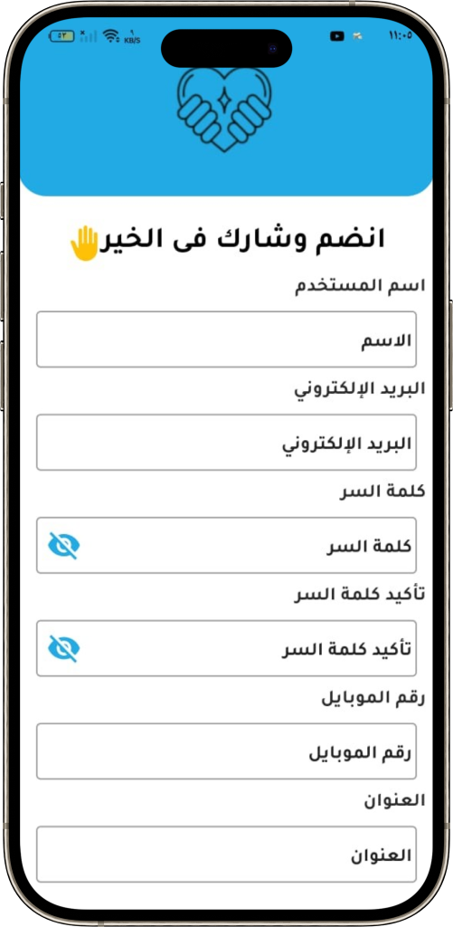
Register Screen

Slide 13
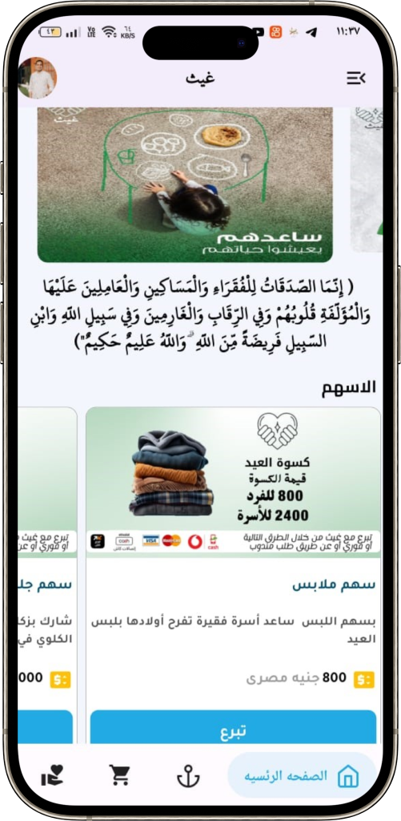
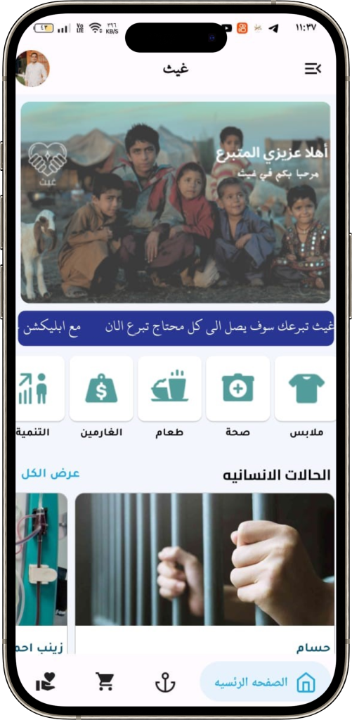
Home Page

Slide 14
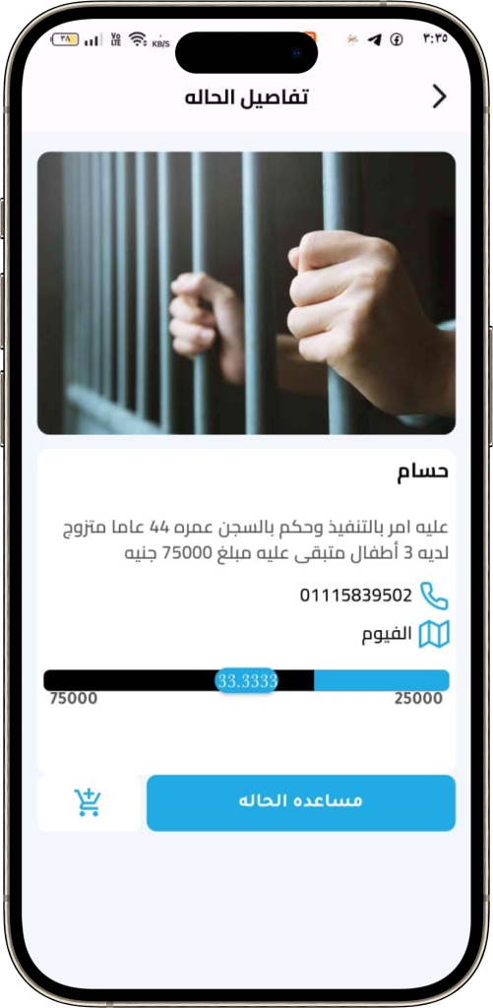
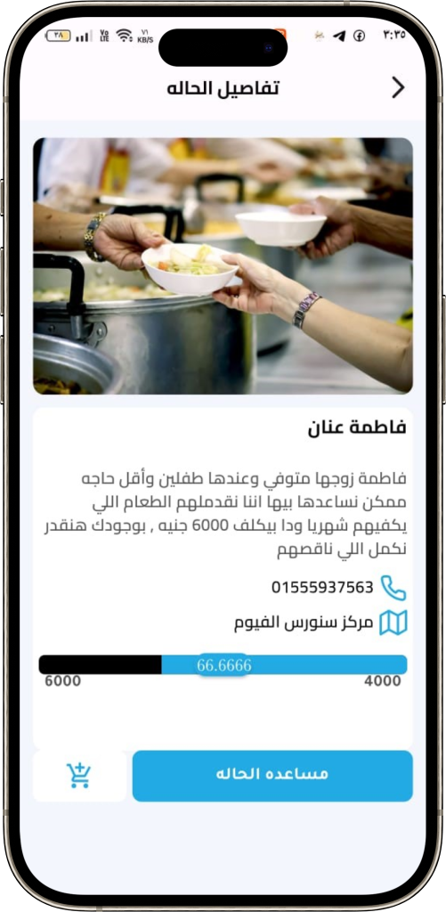
Case details Page

Slide 15
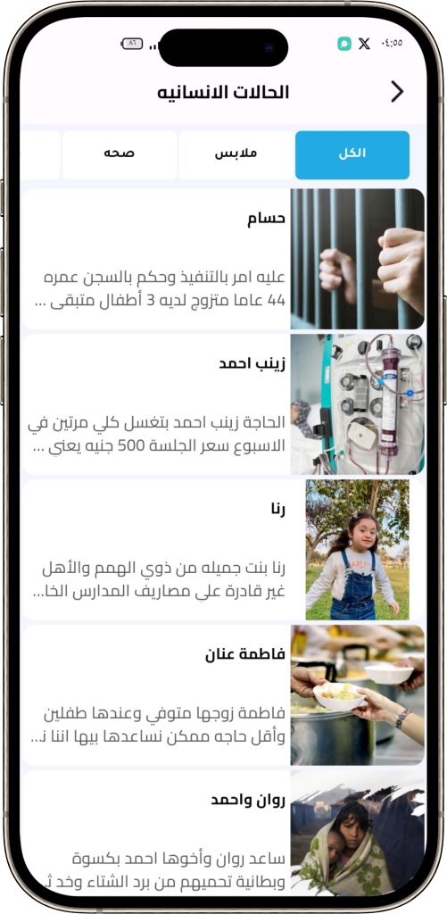
Donation Cases Page

Slide 16
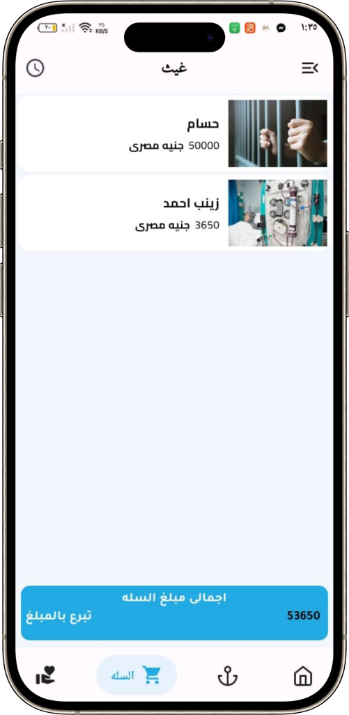
Donation Cart Page

Slide 17
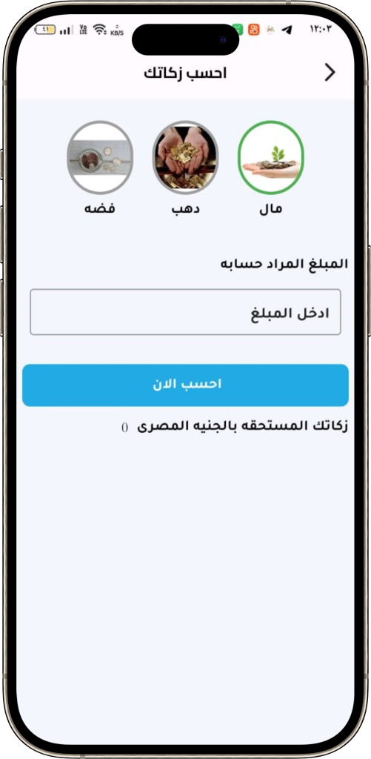
Zakat (Money) Calculator

Slide 18
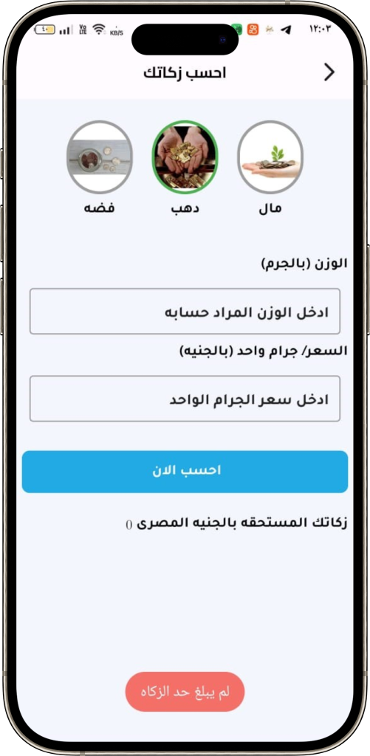
Zakat (Gold) Calculator

Slide 19
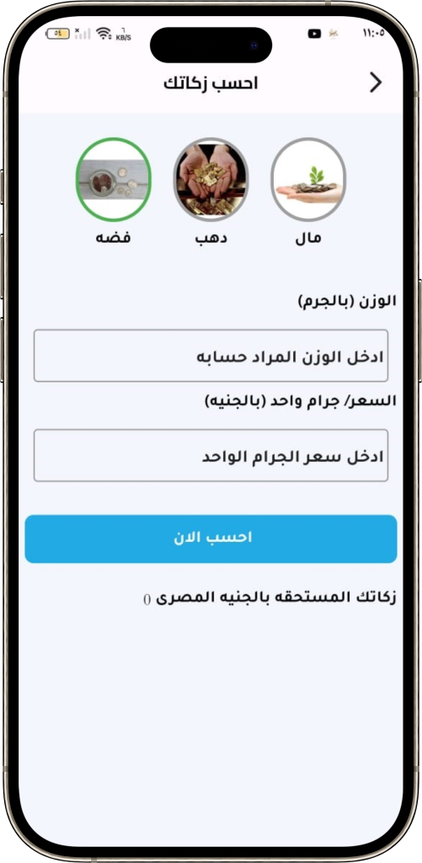
Zakat (Silver) Calculator

Slide 20
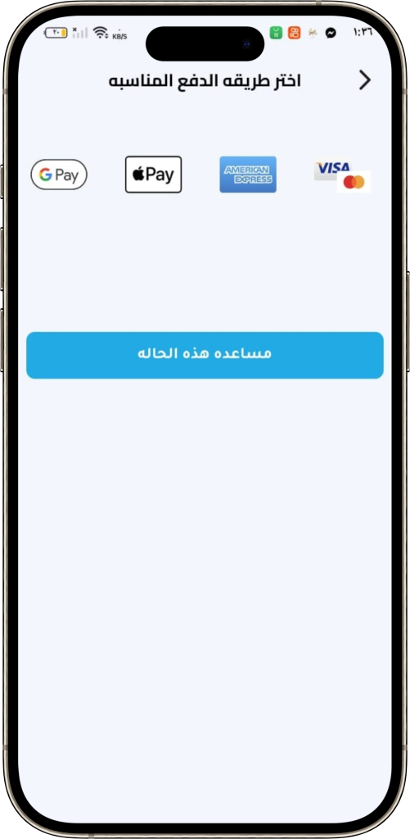
Payment Methods

Slide 21
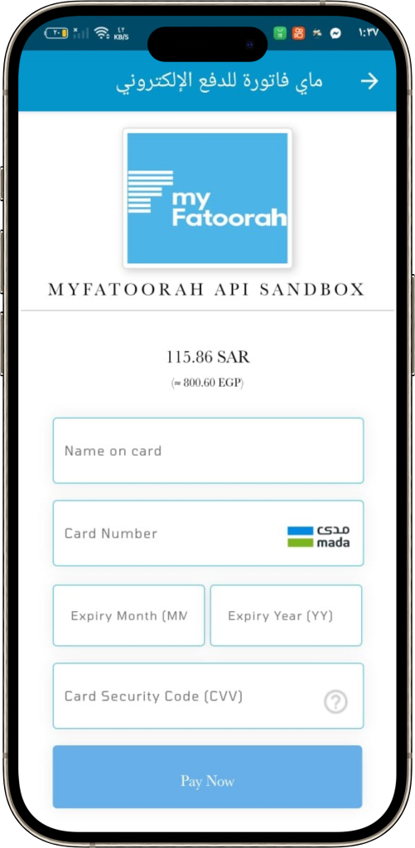
Payment details Page

Slide 22
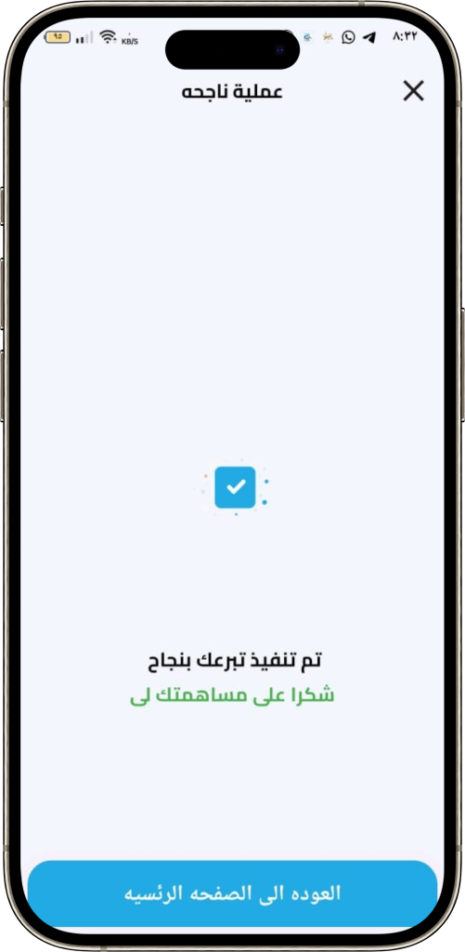
Payment Success Check Message

Slide 23
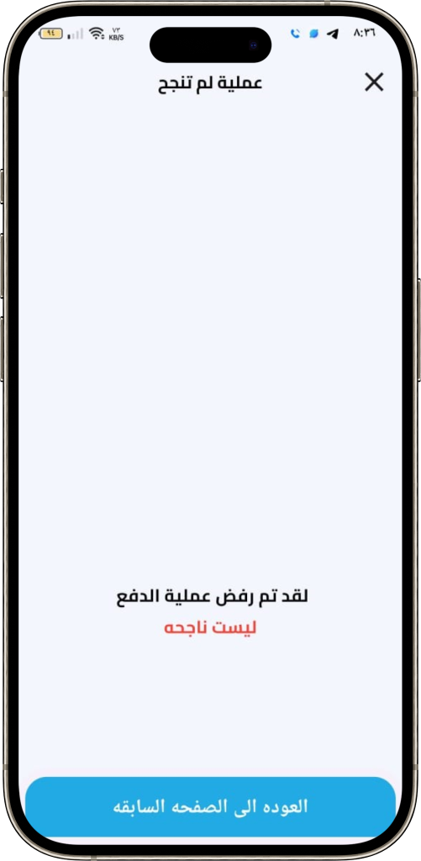
Payment failed Check Message

Slide 24
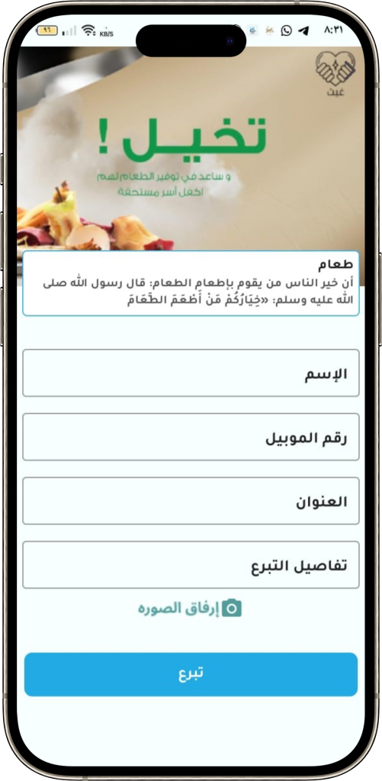
Form of donations (Food)

Slide 25
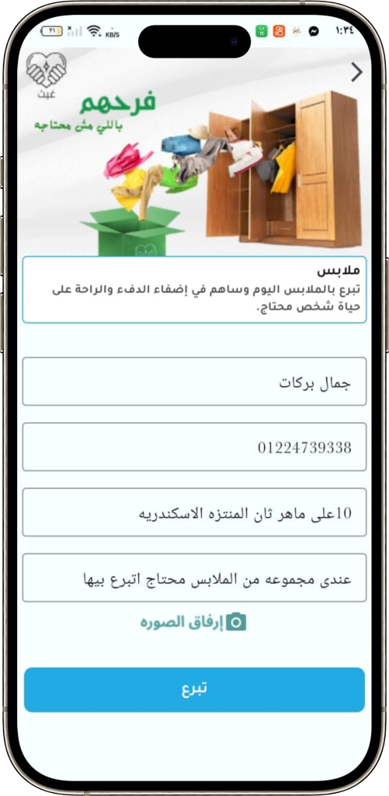
Form of donations (Clothes)

Slide 26
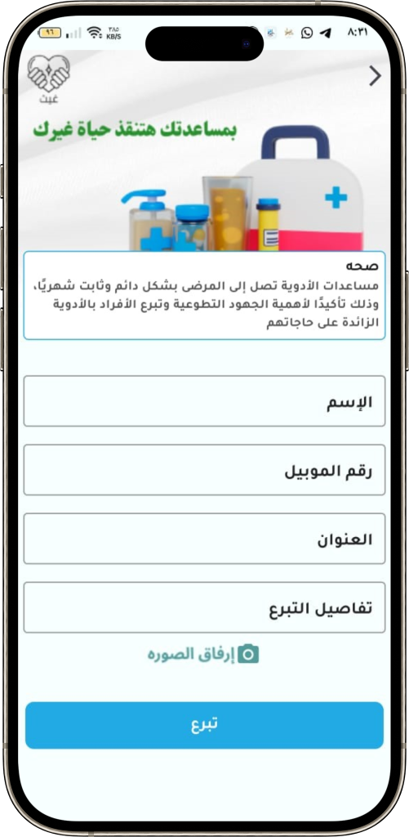
Form of donations (Medicine)

Slide 27
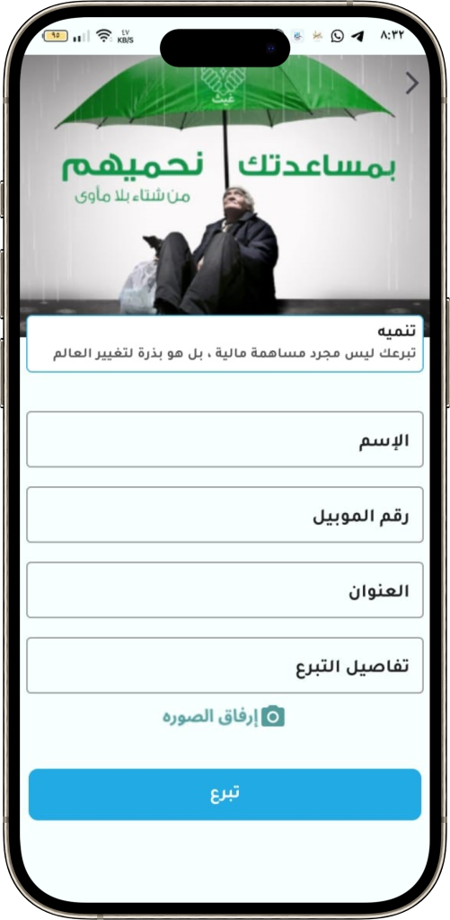
Form of donations (Development)

Slide 28
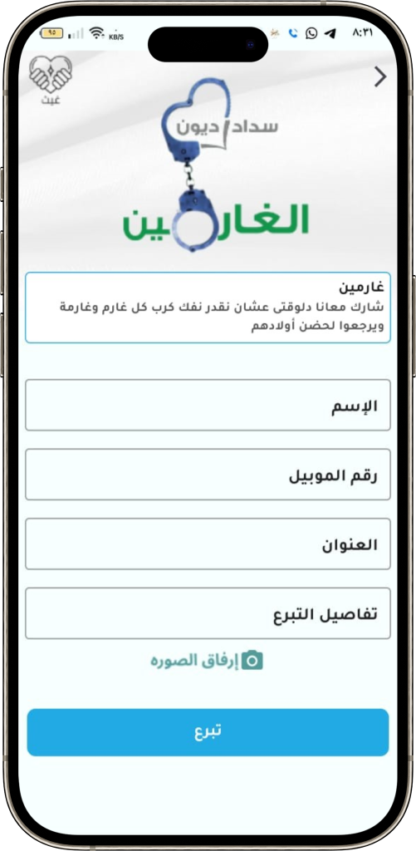
Form of donations (Debtors)

Slide 29
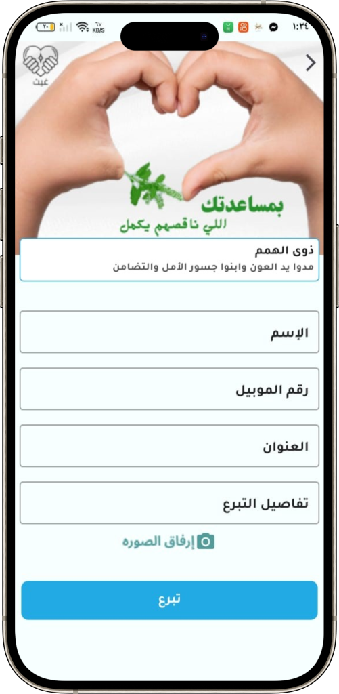
Form of donations (people of determination)

Slide 30
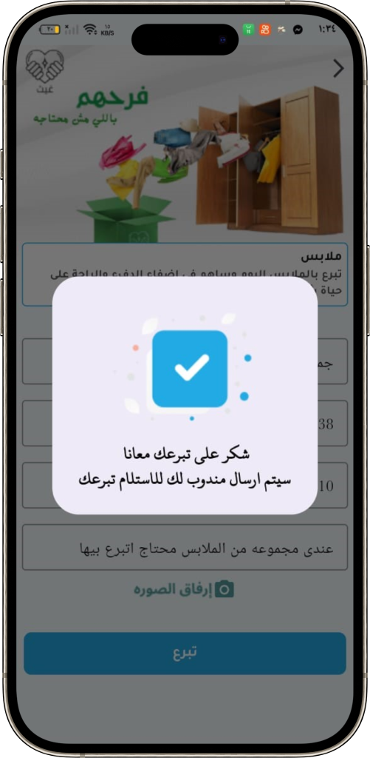
Form Completed Message

Slide 31
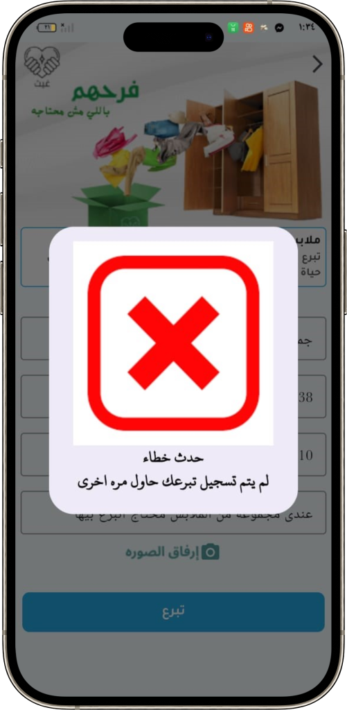
Form Failed Message

Slide 32
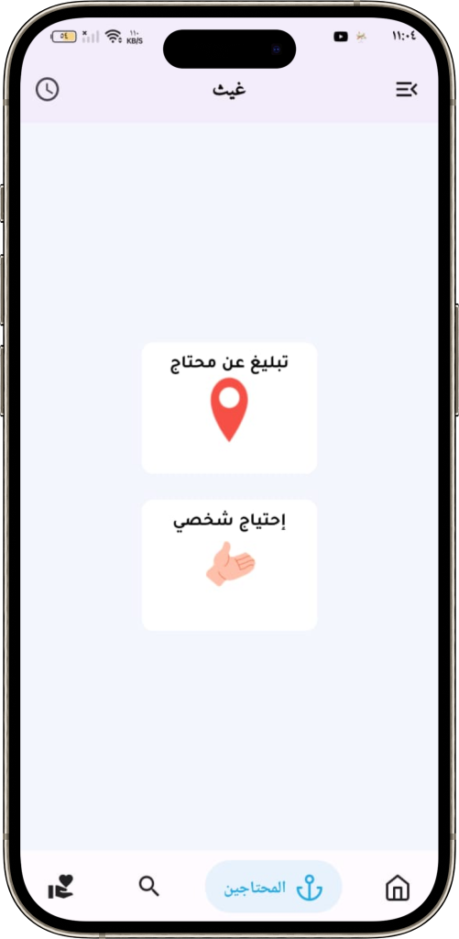
Choose Needy Donation Kind

Slide 33
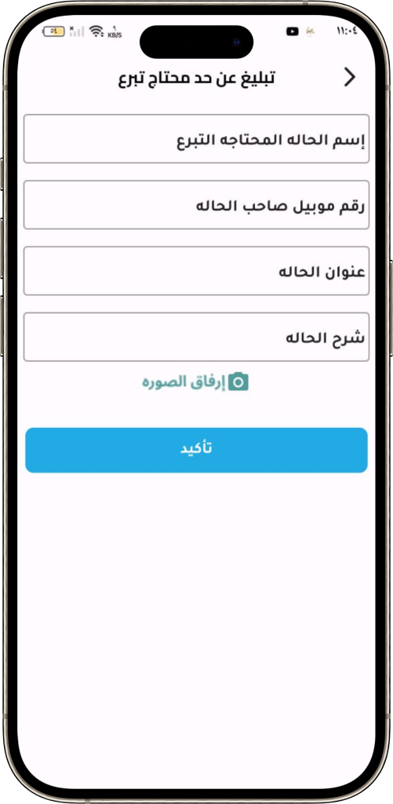
Report for a needy Person

Slide 34
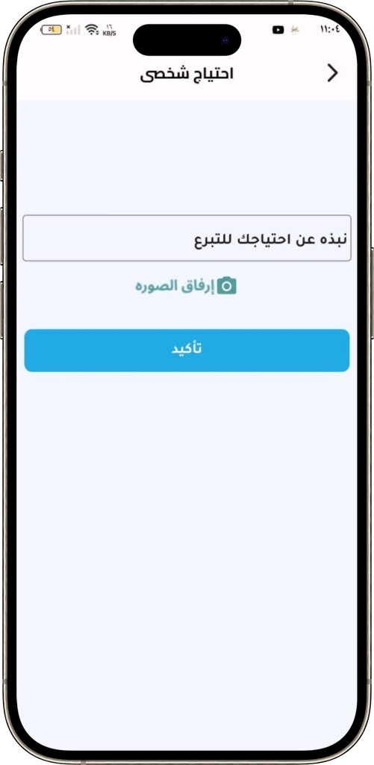
Report for personal Need

Slide 35
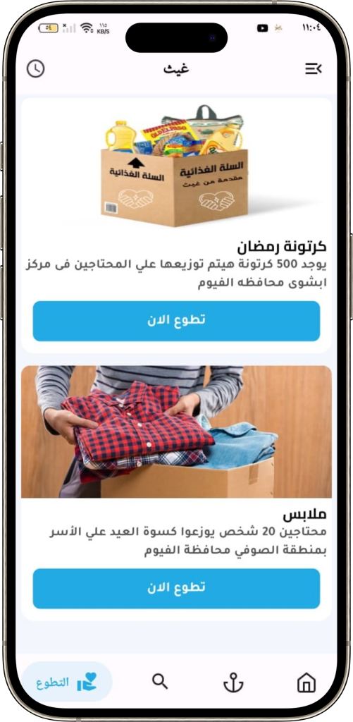
Volunteer Campaigns

Slide 36
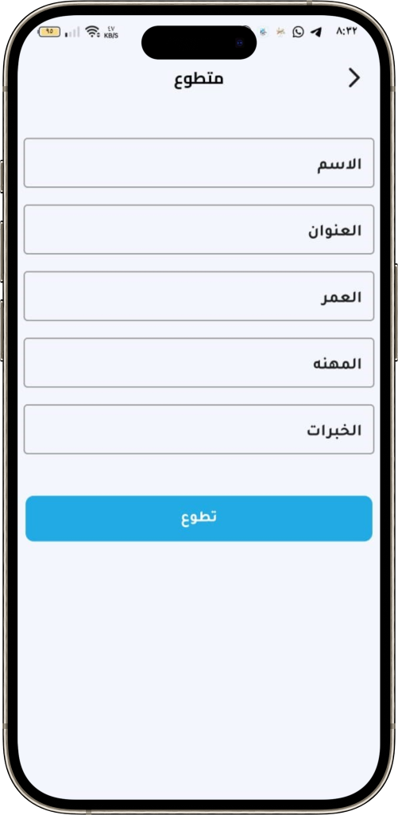
Volunteer form

Slide 37
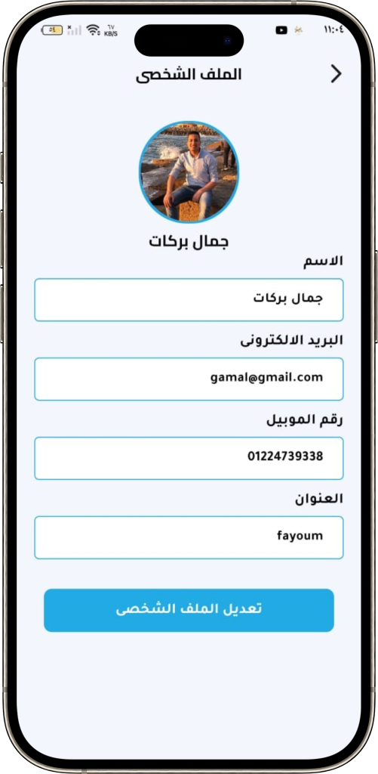
Profile Page

Slide 38
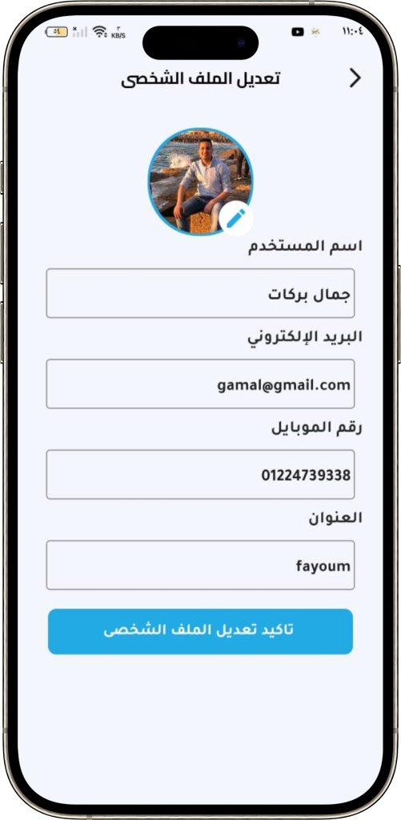
Edit Profile Page

Slide 39
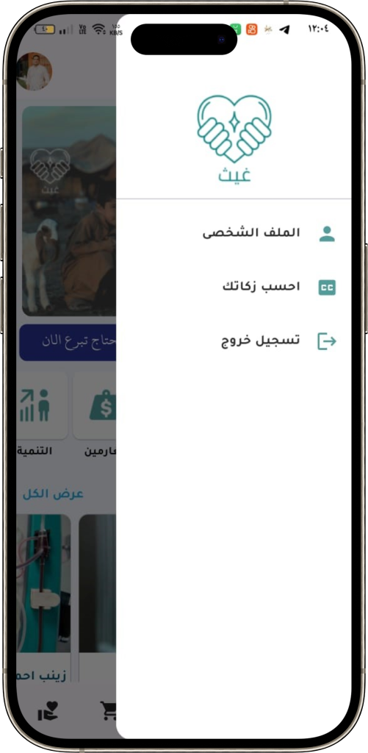
Drawer

Slide 40
Thank You
Any Question?!

